Slide 1
Software Requirement Specifications
Team Argus

Slide 2
Overview
Product Concept
Product Description & Functional Overview
Customer Requirements
Packaging Requirements
Performance Requirements
Safety Requirements
Maintenance & Support Requirements
Other Requirements
Acceptance Criteria
Use Cases
Feasibility Requirements
Future Items

Slide 3
Product Concept
What is it?
Data Transfer Device
Pixelsense Casino Software
Purpose and Use
Casino Chip Tracker
Device SDK
Intended Audience

Slide 4
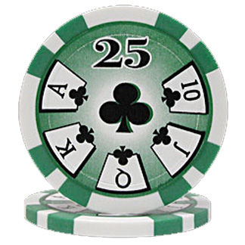

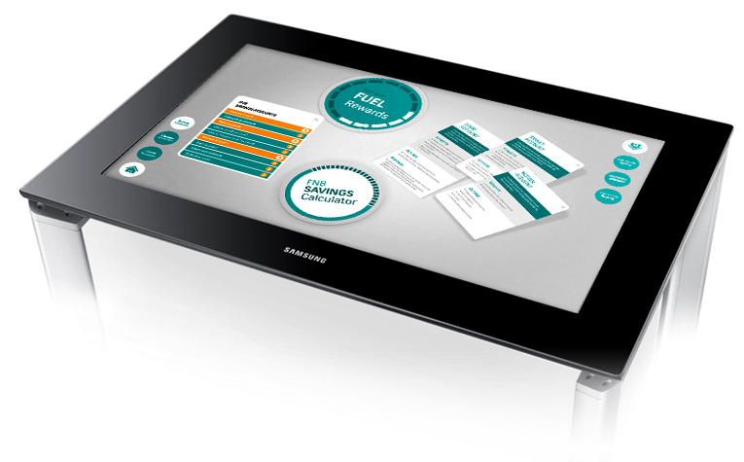
Product Description
Multi-component anti-cheating system for casinos
Consists of:
PixelSense Lynx Device Database

Slide 5
Product Description
Core Purpose:
Transfer data back and forth between the Lynx and PixelSense via light only
Why?
Avoid data interception and modification

Slide 6
Product Description
System Process
Lynx checked out to player
Player will place Lynx on table to start playing
Customer chooses desired game
Score and money are stored on Lynx and DB
Player finishes game and returns Lynx
Data is cross matched with DB for verification
Player cashes out

Slide 7
2.1 Features and Functions
Core Features:
View data on tablet/computer
Optical communication between PixelSense and Lynx
All transactions are backed up to an external server
Lynx should be automatically detected by app
All communication should be done locally, optically or hardlined

Slide 8
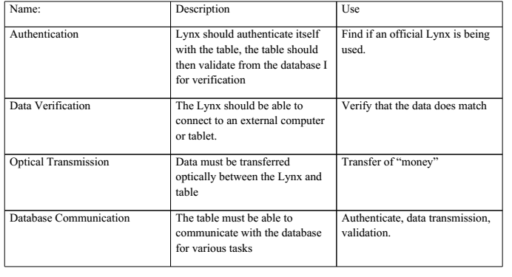
2.1 External Input and Outputs
No direct communication
between user and Lynx
2-Way communication
between Lynx and
PixelSense
External Database
connection
Serial output to tablet

Slide 9
Customer Requirements
3.1 The product shall be able to send data optically
3.1.1 Description: The product must be able to send specifically timed streams of light as bits of information and send them in a way a receiving unit can interpret it.
3.1.2 Source: The requirement is from Professor Gergely Zaruba.
3.1.3 Constraints: The position of the device on the table may cause writing problems. The protocol that handles writing should be software agnostic; not relying on specific programs in order for it to work.
3.1.4 Standards: none
3.1.5 Priority: 5 - Very High

Slide 10
Customer Requirements
3.2 The product shall be able to read data optically
3.2.1 Description: The product must be able to receive specifically timed streams of light as bits of information and interpret them correctly, storing the data in necessary.
3.2.2 Source: The requirement is from Professor Gergely Zaruba.
3.2.3 Constraints: The position of the device on the table may cause writing problems. The protocol that handles writing should be software agnostic; not relying on specific programs in order for it to work.
3.2.4 Standards: none
3.2.5 Priority: 5 - Very High

Slide 11
Customer Requirements
3.3 All work done by the product involving optical communication will be compiled into a well documented library
3.3.1 Description: A suite of functions designed to handle optical communication between capable hardware will be available in a portable SDK library.
3.3.2 Source: The requirement is from Professor Gergely Zaruba.
3.3.3 Constraints: none
3.3.4 Standards: none
3.3.5 Priority: 5 - Very High

Slide 12
Customer Requirements
3.4 The test device must have a serial port for diagnostic analysis and testing
3.4.1 Description: Lynx, the constructed optical device, will have a serial port to check if data was properly collected, and stored into the device.
3.4.2 Source: The requirement is from Professor Gergely Zaruba.
3.4.3 Constraints: none
3.4.4 Standards: none
3.4.5 Priority: 5 - Very High

Slide 13
Customer Requirements
3.5 The device and table’s communication must be error tolerant
3.5.1 Description: All data sent should be received intact, and be identical to the original message using forward error correction.
3.5.2 Source: The requirement is from Professor Gergely Zaruba.
3.5.3 Constraints: No more than two bit flips occur within a 4 bit window.
3.5.4 Standards: none
3.5.5 Priority: 5 - Very High

Slide 14
Customer Requirements
3.6 Communication between both devices must sustain a reliable connection
3.6.1 Description: The protocol will have a system to detect missing or corrupt data, and replace the missing pieces with the correct. Repeat requests must be completed within a 200ms window.
3.6.2 Source: The requirement is from Professor Gergely Zaruba.
3.6.3 Constraints: All data sent should be received intact, and be identical to the original message with these feature.
3.6.4 Standards: none
3.6.5 Priority: 5 - Very High

Slide 15
Customer Requirements
3.7 Software will be built to showcase the optical transfer protocol and the built device
3.7.1 Description: A program will be supplied to demonstrate the capabilities of the optical communication SDK, and Lynx. The program will play a game of Blackjack, with the device holding chip information.
3.7.2 Source: The requirement is from Professor Gergely Zaruba.
3.7.3 Constraints: none
3.7.4 Standards: none
3.7.5 Priority: 4 - High

Slide 16
Customer Requirements
3.8 Players must use an optic device to play the casino game
3.8.1 Description: The program will wait to identify a Lynx device, and will attempt to attain its information. This act will log a player into a table and have hands dealt to him/her. The program should be able to recognize multiple devices before, during, and after a round of play.
3.8.2 Source: The requirement was designated by the team as part of the demo program.
3.8.3 Constraints: none
3.8.4 Standards: none
3.8.5 Priority: 3 - Moderate

Slide 17
Customer Requirements
3.9 The casino game will player and interact with players by the rules of Blackjack
3.9.1 Description: Players logged into and player a game are subject to the rules of Blackjack, including rules relating to betting, hitting, passing, double downs, splitting, insurance, and pushing.
3.9.2 Source: The requirement was designated by the team as part of the demo program.
3.9.3 Constraints: none
3.9.4 Standards: none
3.9.5 Priority: 3 - Moderate

Slide 18
Customer Requirements
3.10 The casino game must pull player information from a lynx device
3.10.1 Description: A player’s chip count will be stored in a Lynx device, and retrieved when displaying it for a user to place a bet.
3.10.2 Source: The requirement was designated by the team as part of the demo program.
3.10.3 Constraints: none
3.10.4 Standards: none
3.10.5 Priority: 3 - Moderate

Slide 19
Customer Requirements
3.11 The casino game must write modified player information to a lynx device
3.11.1 Description: When a player makes a bet, the chips at stake should be deducted from a retrieved player’s total chip count, and updated in the player’s Lynx device. A similar transaction occurs when adding winnings from a round of play.
3.11.2 Source: The requirement was designated by the team as part of the demo program.
3.11.3 Constraints: This transaction must be atomic. Either both a bet is placed and the chips deducted, or neither happen.
3.11.4 Standards: none
3.11.5 Priority: 3 - Moderate

Slide 20
Customer Requirements
3.12 The casino game must allow players to cash out/leave the table safely
3.12.1 Description: A player is allowed to leave the table before or after a bet, but any money at stake should be unavailable to the leaving player.
3.12.2 Source: The requirement was designated by the team as part of the demo program.
3.12.3 Constraints: This transaction must be atomic.
3.12.4 Standards: none
3.12.5 Priority: 3 - Moderate

Slide 21
Customer Requirements
3.13 The game requires a debug/admin mode to test systems
3.13.1 Description: While testing, play is accessible through the table itself, with controls and chip count being stored in the table. This system would allow for program unit testing without the Lynx device.
3.13.2 Source: The requirement was designated by the team as part of the demo program.
3.13.3 Constraints: none
3.13.4 Standards: none
3.13.5 Priority: 3 - Moderate

Slide 22
4. Packaging Requirements
4.1 Attachable to Tablet
4.1.1 Description: The Lynx must be attachable and detachable physically from the tablet it is connected to. This is referring to a mechanism so the Lynx can physically stay on the tablet it is connected to, not the serial connection with the cord plugged into the tablet.
4.1.2 Source: Dr. Zaruba
4.1.3 Constraints: The Lynx will only attachable/detachable for the one tablet we chose to develop on. (Only referring to the mechanism to keep the Lynx physically attached to the tablet, not the serial connection with the cord plugged into the tablet.)
4.1.4 Standards: None
4.1.5 Priority: 3 - Moderate

Slide 23
4. Packaging Requirements
4.2 Device Assembled
4.2.1 Description: The Lynx will be assembled and ready for use.
4.2.2 Source: Dr. Zaruba
4.2.3 Constraints: None
4.2.4 Standards: None
4.2.5 Priority: 4 – High

Slide 24
4. Packaging Requirements
4.3 Lynx as a Tablet Case
4.3.1 Description: The Lynx will serve as a tablet case for the tablet we chose to develop for.
4.3.2 Source: Dr. Zaruba
4.3.3 Constraints: Case will only fit the tablet we chose to develop for.
4.3.4 Standards: None
4.3.5 Priority: 2 – Low

Slide 25
4. Packaging Requirements
4.4 SDK on USB Flash Drive
4.4.1 Description: The Lynx’ SDK for the PixelSense table, the Secure Transfer Device, and the connected device will be provided on a USB flash drive for use on Windows.
4.4.2 Source: Dr. Zaruba
4.4.3 Constraints: None
4.4.4 Standards: None
4.4.5 Priority: 4 – High

Slide 26
4. Packaging Requirements
4.5 PixelSense Casino Software
4.5.1 Description: The PixelSense casino software will be provided on a USB Flash Drive which can be used to install the software on the PixelSense table.
4.5.2 Source: Dr. Zaruba
4.5.3 Constraints: None
4.5.4 Standards: None
4.5.5 Priority: 4 – High

Slide 27
4. Packaging Requirements
4.6 PC Casino Companion Software
4.6.1 Description: The PC Casino Companion Software will be packaged as an executable file on an USB Flash Drive that can be used on compatible Windows PCs.
4.6.2 Source: Dr. Zaruba
4.6.3 Constraints: None
4.6.4 Standards: None
4.6.5 Priority: 4 – High

Slide 28
4. Packaging Requirements
4.7 Android Casino Software
4.7.1 Description: The Android Casino Software will be packaged in an APK on an USB Flash Drive that can be installed on compatible Android tablets.
4.7.2 Source: Dr. Zaruba
4.7.3 Constraints: None
4.7.4 Standards: None
4.7.5 Priority: 4 – High

Slide 29
5. Performance Requirements
Core Performance Components
Optical Transfer
Data Translation
Connection Times
Authentication Times
Software Boot Times
Data r/w

Slide 30
5. Performance Requirements
5.1 Minimum Data Transfer Rate
5.1.1 Description: Data transfer must be consistent at minimum of 200 bits/sec
5.1.2 Source: Dr. Zaruba
5.1.3 Constraints: PixelSense refresh rate is between 30-60Hz, this must be kept in mind
5.1.4 Standards: None
5.1.5 Priority: 4 – High

Slide 31
5. Performance Requirements
5.2 Data Translation
5.2.1 Description: Converting optical data to binary data for later readability should be at most 1 second.
5.2.2 Source: Team Argus
5.2.3 Constraints: None
5.2.4 Standards: None
5.2.5 Priority: 3 – Moderate

Slide 32
5. Performance Requirements
5.3 Authentication Time
5.3.1 Description: The Lynx should not take too long to authenticate its integrity with the PixelSense. Time should at most be 5 seconds.
5.3.2 Source: Dr. Zaruba
5.3.3 Constraints: Must be 2-Way authentication
5.3.4 Standards: None
5.3.5 Priority: 3 – Moderate

Slide 33
5. Performance Requirements
5.4 Software Boot Times
5.4.1 Description: Software should not take a long time to boot and load data. This should be less than 10 seconds.
5.4.2 Source: Team Argus
5.4.3 Constraints: PixelSense processing power as well as concurrent PixelSense background processes
5.4.4 Standards: None
5.4.5 Priority: 4 – High

Slide 34
5. Performance Requirements
5.5 Data Processing Times
5.5.1 Description: Processing data from the Lynx should take at most 1 second.
5.5.2 Source: Team Argus
5.5.3 Constraints: Depends on microcontroller speed
5.5.4 Standards: None
5.5.5 Priority: 4 – High

Slide 35
5. Performance Requirements
5.6 Overall Connection Times
5.6.1 Description: Connection times to the Lynx, tablet and DB should take no longer than 5 seconds from each other.
5.6.2 Source: Dr. Zaruba
5.6.3 Constraints: Network speed and hardware transmission limitations
5.6.4 Standards: None
5.6.5 Priority: 3 – Moderate

Slide 36
6. Safety Requirements
Core Safety
Protect system and devices
Protect end-user

Slide 37
6. Safety Requirements
6.1 No Sharp Edges
6.1.1 Description: Lynx must not have any sharp edges
6.1.2 Source: Team Argus
6.1.3 Constraints: None
6.1.4 Standards: None
6.1.5 Priority: 4 – High

Slide 38
6. Safety Requirements
6.1 Protective Case Around Lynx
5.6.1 Description: Lynx should have a protective case to prevent exposure to liquids
5.6.2 Source: Team Argus
5.6.3 Constraints: None
5.6.4 Standards: None
5.6.5 Priority: 4 – High

Slide 39
7. Maintenance & Support Requirements
User Manual
It shall include step by step guide to use the SDK with device & software on Surface Table.
Priority: 4 - High
Software Installation
Software will be provided to interact between device and PixelSense Table. Should work on Windows 7.
Priority: 5 - Very High

Slide 40
7. Maintenance & Support Requirements
Source Code / SDK
Source code shall be provided to the customer as final deliverable. Basic Software Development Kit shall be provided for future developments.
Priority: 3 - Moderate
Hardware Support
Device (Lynx) shall be ready to use on any PixelSense Table running Windows 7.
Priority: 5 - Very High

Slide 41
8. Other Requirements
American English Standard
-Description: The PixelSense Secure Transfer shall use American English as the default language for any text or audio speech.
Source: Team Argus
Constraints: None
Standards: None
Priority: 4 - High

Slide 42
8. Other Requirements
User Friendly Interface
-Description: The PixelSense Secure Transfer shall have a user interface that can be learned in under 2 hours, and includes guidance to aid the user during use of the application.
Source: Team Argus
Constraints: None
Standards: None
Priority: 4 - High

Slide 43
Acceptance Criteria
9.1 The device can securely transfer information to the PixelSense table using an array of sensors
9.1.1 Requirement(s) addressed: Requirement 3.1 - Send Data Optically.
9.1.2 Verification Procedure: The customer will use the software provided for the PixelSense table and the tablet connected to the Lynx to verify that the table can receive information from the tablet connected to the Lynx. All other forms of communications will be turned off on both the tablet and the table to insure that the Lynx alone was transmitting the information.

Slide 44
Acceptance Criteria
9.2 The device can securely receive information from the PixelSense table using an array of sensors
9.2.1 Requirement(s) addressed: Requirement 3.2 - Read Data Optically.
9.2.2 Verification Procedure: The customer will use the software provided for the PixelSense table and the tablet connected to the Lynx to verify that the table can send information to the tablet connected to the Lynx. All other forms of communications will be turned off on both the tablet and the table to insure that the Lynx alone was transmitting the information.

Slide 45
Acceptance Criteria
9.3 An SDK is provided that can be used to program for the device created
9.3.1 Requirement(s) addressed: Requirement 3.3 - All work done by the product involving optical communication should be compiled into a well documented library
9.3.2 Verification Procedure: The customer will be given the code used to create the secure connection between the table and the Lynx, as well as any documentation created for the Lynx, and verify whether or not the resources provided are sufficient enough to create an application using the Lynx and the table.

Slide 46
Acceptance Criteria
9.4 The transfer rate of the Lynx is at least 200 bits/sec
9.4.1 Requirement(s) addressed: Requirement 5.1 – Minimum Transfer Rate
9.4.2 Verification Procedure: The customer will use the software developed for the Lynx and the table, as well as any tools the customer deems necessary, to verify the Lynx satisfies the minimum data transfer throughput requirements.

Slide 47
Acceptance Criteria
9.5 The Lynx has a port that can be used to connect to a tablet
9.5.1 Requirement(s) addressed: Requirement 3.4 – Device must have a serial port.
9.5.2 Verification Procedure: The customer will use the port on the Lynx and verify that when an Android tablet is connected to it, the Android tablet can transfer data through the Lynx using the software provided.

Slide 48
Acceptance Criteria
9.6 The software is provided for the PixelSense table that demonstrates the connection between the Lynx and the table
9.6.1 Requirement(s) addressed: Requirement 3.7 – Software will be built to show optical transfer protocol.
9.6.2 Verification Procedure: The customer will use the casino software provided and verify that is demonstrates the secure connection between the Lynx (with the tablet connected to it) and the PixelSense table. The customer will do this using the software provided for the PixelSense table, as well as the software for the tablet connected to the secure transfer Lynx.

Slide 49
Acceptance Criteria
9.7 The data connection between Lynx and PixelSense is error tolerant and can recover from errors if necessary.
9.7.1 Requirement(s) addressed: 3.5 The device and table’s communication must be error tolerant 3.6 Both devices must sustain a reliable connection
9.7.2 Verification Procedure: The customer will use transfer information between the tablet connected to Lynx and the Pixelsense table and verify that if errors from sending data has occurred, reconnection is established and error recovery occurs in for for the data to complete transmission.

Slide 50
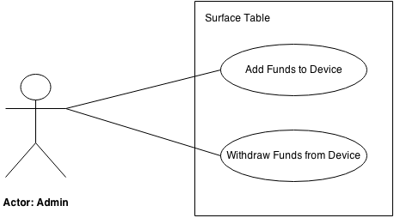
10.1 Use Case <<Microsoft Surface Table subsystem>>

Slide 51
10.1 Use Case <<Microsoft Surface Table subsystem>>
10.1.1. Add Funds to Lynx
Scenario: User/Player requests certain amount of funds to be inserted into the Lynx to begin the game. Admin opens the android application on android tablet. He enters the User ID and selects add funds option. Application displays the add funds page. Admin adds the fund amount into input field. The application processes the request being transferred to Lynx. Application displays the confirmation of funds being and ask admin to connect Lynx via serial port. Once Lynx is connected, funds are added to Lynx.
Actor: Admin
TUCBW Admin enters User ID into the system and click “Add Funds” button.
TUCEW Admin sees the confirmation of funds being added to the Lynx.

Slide 52
10.1 Use Case <<Microsoft Surface Table subsystem>>
10.1.2. Withdraw Funds from Lynx
Scenario: User/Player requests to withdraw the funds from the Lynx when he/she is done playing. Admin opens the android application on the tablet and enters the User ID. Admin selects withdraw funds option. He then connects the Lynx via serial port. System displays total amount remaining in the Lynx, and asks for confirmation. Admin taps confirm button and system processes the request. System flushes the Lynx data into the system through serial port and resets the Lynx.
Actor: Admin
TUCBW Admin enters User ID into the system and click “Withdraw Funds: button.
TUCEW Admin sees the confirmation of funds being withdrawn into the User Account.

Slide 53
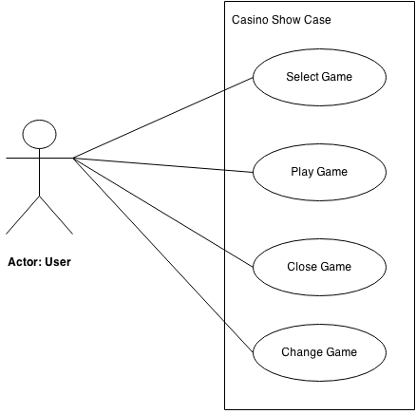
10.2 Use Case <<Casino Showcase subsystem>>

Slide 54
10.2 Use Case <<Casino Showcase subsystem>>
10.2.1. Select Game
Scenario: User enters Casino Showcase software on PixelSense table. System displays the Game selection menu. User selects a game from options available to play. System opens the new page with area to put Lynx.
Actor: User
TUCBW User taps Game Icon from Available Games on the screen.
TUCEW User sees the Game opened which he/she tapped.

Slide 55
10.2 Use Case <<Casino Showcase subsystem>>
10.2.2. Play Game
Scenario: User selects a game from multiple options available to play. System displays area to put Lynx and option to continue without Lynx. User puts the Lynx on table on desired location to begin the play.
Actor: User
TUCBW User places the Lynx on the ‘Lynx spot’ of the game.
TUCEW User sees the message ‘Access Granted with Lynx’ with his/her details & funds.

Slide 56
10.2 Use Case <<Casino Showcase subsystem>>
10.2.3. Close Game
Scenario: User selects ‘Exit’ button from the current game on bottom right of the screen. System prompts the user to confirm the exit from the game with a dialogue box. User confirms by pressing confirm button in pop-up dialogue box. System saves the game data for the user into Casino Showcase database. User is then redirected back to Casino Showcase game selection screen.
Actor: User
TUCBW User selects ‘Exit’ Button from the current game.
TUCEW User sees the Casino Showcase game selection Screen.

Slide 57
10.2 Use Case <<Casino Showcase subsystem>>
10.2.4. Change Game
Scenario: User selects ‘Exit’ button from the current game on bottom right of the screen. System saves the game data for the user into Casino Showcase database. System displays the game selection menu. System opens the new page with area to put Lynx as user selects the new game.
Actor: User
TUCBW User selects ‘Exit’ Button from the current game.
TUCEW User selects a new game from the game selection screen.

Slide 58
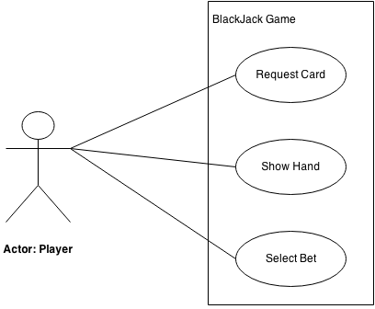
10.3 Use Case <<Blackjack Game subsystem>>

Slide 59
10.3 Use Case <<Blackjack Game subsystem>>
1. Request Card
Scenario: Player requests a new card by pressing a button on the screen. System gets the new card from the shuffled deck array. System displays a new card from the to the Player area. Player sees a new card.
Actor: Player
TUCBW Player presses ‘Hit’ button on the screen.
TUCEW Player sees the card opened in his/her area.

Slide 60
10.3 Use Case <<Blackjack Game subsystem>>
2. Show Hand
Scenario: Player requests Dealer to show hand by pressing “Show” button on the screen. System gets a new cards for the dealer from shuffled deck array till the sum reaches 21 for all cards. Player sees cards in the dealer Area till the sum reaches 21.
Actor: Player
TUCBW Player presses ‘Stand’ Button on the screen.
TUCEW Player sees the card of dealer opened in Dealer Area.

Slide 61
10.3 Use Case <<Blackjack Game subsystem>>
3. Select Bet
Scenario: Player selects bet amount before starting the play on the screen. System bets that much amount for the play and displays total amount into ‘Bet Area’. Player sees the final amount of selected Bet amount.
Actor: Player
TUCBW Player selects the chips from chip symbol to ‘Bet Area’.
TUCEW Player sees the final amount of selected Bet Amount.

Slide 62
11. Feasibility Assessment
11.1 Scope Analysis
Scope of Work
Construct Lynx
Software Development Kit for Lynx
Casino Showcase Software

Slide 63
11. Feasibility Assessment
11.2 Research
Research completed:
Hardware (AT Mega 328 chip, Arduino)
Optimal programming language (C#)
Possible game engines (Unity & XNA)
PixelSense Capabilities (refresh rate, touch handling, SDK)
Possible Tablets (with USB Master: Acer A500)

Slide 64
11. Feasibility Assessment
Research to be completed:
Game engines (will we need Unity)
Hardware (photo diodes)
C# (Gain more experience in this language)
Game development (incorporating Lynx into application)
PixelSense (Sensitivity, response rate, object discovery)

Slide 65
11. Feasibility Assessment
11.3 Technical Analysis
Hardware
Lynx
Array of transmitters and receivers
Microcontroller
USB Serial Breakout Board
Printed Circuit Board
Software
PixelSense Casino Showcase
Mobile application
Software Development Kit

Slide 66
11. Feasibility Assessment
11.4 Cost Analysis
Description | Cost
Lynx | $100 - 150.00
Tablet with master USB port | $75 - 100.00
Microsoft PixelSense | $0.00
Total Cost: | $175 - 250.00
Lynx Includes:
Custom Minimal Control Board
Array of Transmitters and Receivers
Printed Circuit Board
USB-Serial Breakout Board
Case

Slide 67
11. Feasibility Assessment
11.5 Resource Analysis
2 Computer Scientists (Brian and Shamikul)
2 Software Engineers (Brandon and Keyur)
1 Computer Engineer (Seth)
1 Microsoft PixelSense

Slide 68
11. Feasibility Assessment
11.6 Schedule Analysis
Program Characteristic | Function Points
Number of Inputs | 17
Number of Outputs | 20
Inquiries | 4
Logical Internal Files | 20
External Interface Files | 19
Total | 80

Slide 69
11. Feasibility Assessment
General System Characteristic | Influence (0-5)
Data Communications | 3
Distributed Data Processing | 0
Performance | 5
Heavily Used Configuration | 1
Transaction Rate | 5
On-Line Data Entry | 0
End-User Efficiency | 3
General System Characteristic | Influence (0-5)
On-Line Update | 0
Complex Processing | 1
Reusability | 5
Installation Ease | 3
Operational Ease | 3
Multiple Sites | 0
Facilitate Change | 3
Total | 32

Slide 70
11. Feasibility Assessment
General Application | Exponent | Estimated Schedule (months)
Best Case | .43 | 6.49
Average Case | .45 | 7.08
Worst Case | .48 | 8.07
Modified Worst Case | .48 | 7.52
Influence Factor
= .65 + ( 32 / 100 )
= .97
Total Adjusted Function Points
= 80 * .97
= 77.6
(Total Adjusted Function Pts)^{Case Exponent}
= # months

Slide 71
12. Future Items
12.1 Add more games to the Casino Program
12.1.1 Description: Before the first betting of a round, give the players an option to changes games. Other games to consider adding are: Poker and variations), Roulette, Baccarat, or Slots
12.1.2 Source: Brainstorming in a team meeting
12.1.2 Constraint: Only if time permits.
12.1.4 Standards: none
12.1.5 Priority: 2 - Low

Slide 72
12. Future Items
12.2 Add Graphical Fidelity to Blackjack
12.2.1 Description: Instead of rudimentary test graphics and menus, the program could expand to use the range the PixelSense table offers, with creative ways to display and interact with chip count and virtual cards. Possibly allow for customizable table images and card faces.
12.2.2 Source: Brainstorming in a team meeting
12.2.2 Constraint: Only if time permits.
12.2.4 Standards: none
12.2.5 Priority: 2 - Low

Slide 73
12. Future Items
12.3 Allow for variety in rule set
12.3.1 Description: Allow before the first bet of a round to change the rules of particular game, such as buy in, ante, poker variation, blackjack move restriction (splitting, double down, insurance), dealer button position, tournament seeding, number of decks used, etc.
12.3.2 Source: Brainstorming in a team meeting
12.3.2 Constraint: Only if time permits.
12.3.4 Standards: none
12.3.5 Priority: 2 - Low

Slide 74
12. Future Items
12.4 Iterate on the Hardware
12.4.1 Description: Through implicit learning with building and researching optical devices, time may be allotted at the end of the project for hardware improvements, to to boost responsiveness, capacity, or battery longevity to the device.
12.4.2 Source: Brainstorming in a team meeting
12.4.2 Constraint: Only if time permits.
12.4.4 Standards: none
12.4.5 Priority: 2 - Low

Slide 75
12. Future Items
12.5 Build additional devices
12.5.1 Description: Blackjack and other forms of poker are more fun in groups. With extra time, additional devices can be built to better emulate a casino table environment.
12.5.2 Source: Brainstorming in a team meeting
12.5.2 Constraint: Only if time permits.
12.5.4 Standards: none
12.5.5 Priority: 2 - Low

Slide 76

Questions?

